Slide 1
Quantum Lecture 4
Bell and EPR
Rotational invariance of Bell state
CHSH inequality
Bell and local realism

Slide 2
Agenda for Lecture 4
8:15 – 9:45 RECAP
9:45 – 10:15 2 Videos
10:30 – 11:30 Coderanch

Slide 3
8:15 – 9:30RECAP
Kahoot https://create.kahoot.it/details/9783af2c-32f6-4e4a-8d8d-de90f223a50e
Your Report of Your Own choice
Symmmetrisk Matricer(Quantum Gates og grader)
Geometrical Representation
Heisenbergs Uncertainty Principle
What’s the basic about the EPR paradox and in particular – Why do You need to have some imagination of what the EPR guyes where up to back in 1935 ?

Slide 4
9:15 – 10:00 2 Videos
Lecture 4.1 Bell and EPR
Lecture 4.2 Rotational invariance of Bell state

Slide 5
10:15 – 11:00 Coderanch
Start with the mybinder.org below
https://hub.gke.mybinder.org/user/gubiithefish-ib-ands-on-session-rvo3jzr4/tree/notebook-exercises
10:15 -> Exercise 1 -
10:30 -> Exercise 2 -
10:45 -> Exercise 3 -

Slide 6
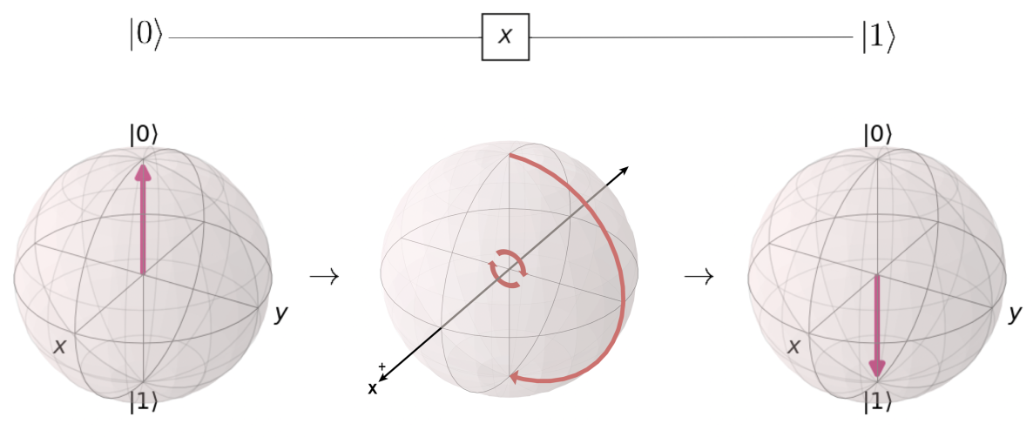
Exercise recaps
What is .measure about
What does the X,Y and Z do as OPERATORS

Slide 7
11:00 – 11:45 2 Videos
Lecture 4.3 CHSH inequality
Lecture 4.4 Bell and local realism

Slide 8
11:45 – 12:30 Lunch

Slide 9
12:30 – 13:15 MatLab
Example 3.1– Page 41
Example 3.2– Page 44
Example 3.3– Page 45
Example 3.4– Page 47

Slide 10
13:30 – 14:00 Coderanch
Continues with the mybinder.org below
https://hub.gke.mybinder.org/user/gubiithefish-ib-ands-on-session-fzvbsbtj/notebooks/notebook-exercises/1.4%20-%20Gate%20operation%20-%20CNOT-Gate.ipynb
13:30 -> 13:45 -> 14:00 -> Lecture 3 ends for today

